Slide 1
2C – Javascript style guide
inherited from Airbnb style guide

Slide 2
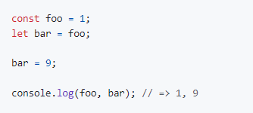
1. Types
Primitives: When you access a primitive type you work directly on its value.
String
Number
Boolean
Null
Undefined
Symbol
Bigint

Slide 3
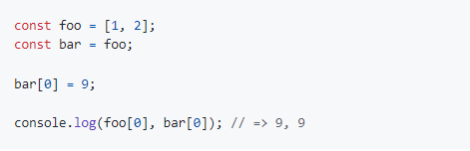
1. Types
Complex: When you access a complex type you work on a reference to its value.
Object
Array
Function

Slide 4
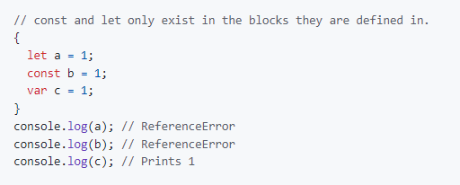
2. References
Use const for all of your references, avoid using var
ensures that references can’t be reassigned
If you must reassign references, use let instead of var
let is block-scoped rather than function-scoped var
Both const and let are block-scoped
whereas var is function-scoped

Slide 5
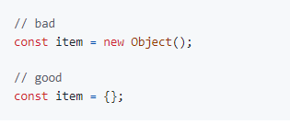
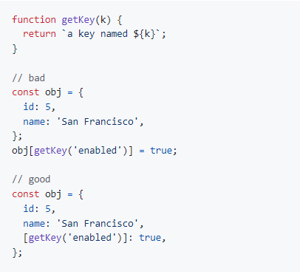
3. Objects
Use the literal syntax for object creation
Use computed property names when creating objects
with dynamic property names
they allow you to define all the properties of an object in one place

Slide 6
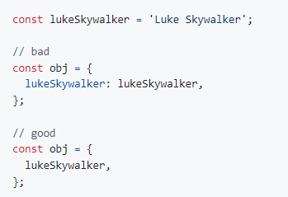
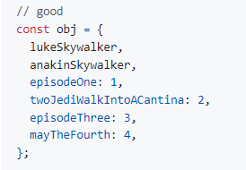
3. Objects
Use property value shorthand
shorter and descriptive.
Group your shorthand properties at the beginning
of your object declaration

Slide 7
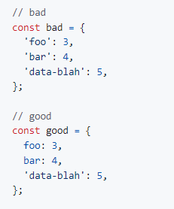
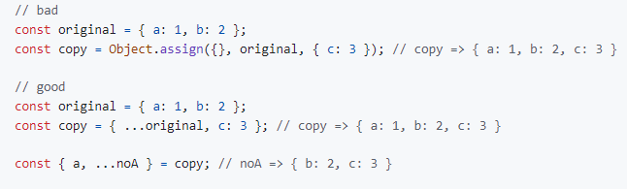
3. Objects
Only quote properties that are invalid identifiers
Prefer the object spread syntax over Object.assign to shallow-copy objects

Slide 8
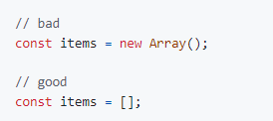
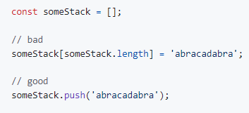
4. Arrays
Use the literal syntax for array creation
Use Array.push instead of direct assignment
to add items to an array.

Slide 9
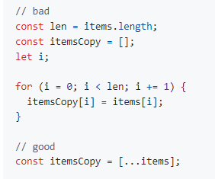
4. Arrays
Use array spreads … to copy arrays
To convert an iterable object to an array, use spreads
… instead of Array.from
Use Array.from for converting an array-like object
to an array
Use Array.from instead of spread … for mapping over
iterables, because it avoids creating an intermediate array

Slide 10
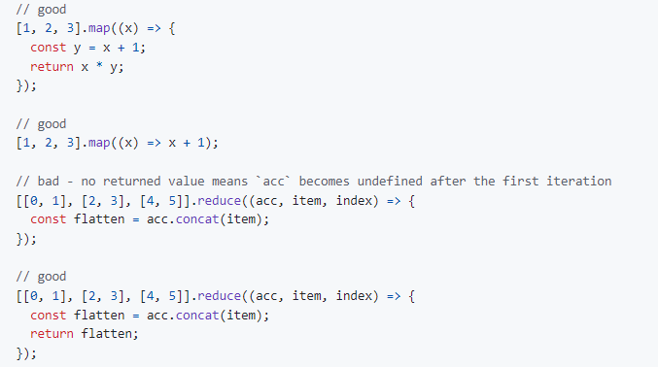
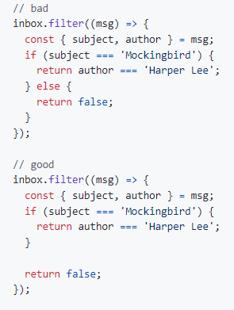
4. Arrays
Use return statements in array method callbacks.
It’s ok to omit the return if the function body consists of a single statement returning an expression without side effects

Slide 11
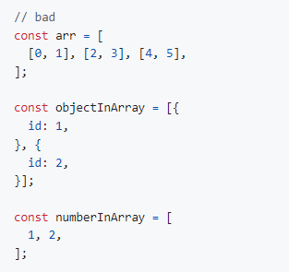
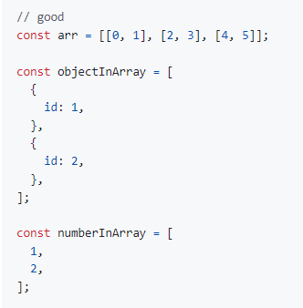
4. Arrays
Use line breaks after opening array brackets and before closing array brackets, if an array has multiple lines

Slide 12
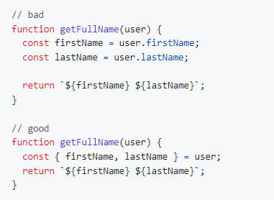
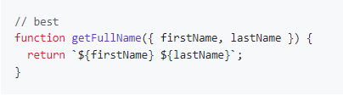
5. Destructuring
Use object destructuring when accessing and using multiple properties of an object
destructuring saves you from creating temporary references for those properties, and from repetitive access of the object.

Slide 13
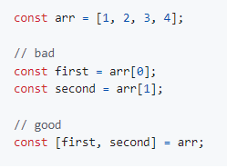
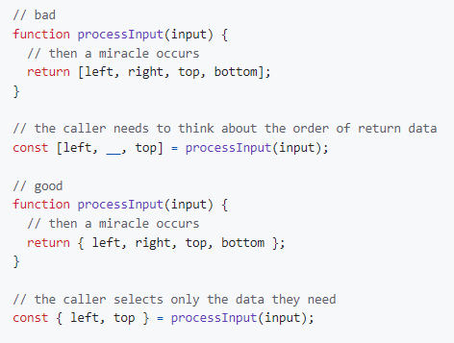
5. Destructuring
Use array destructuring
Use object destructuring for multiple return values, not array destructuring

Slide 14
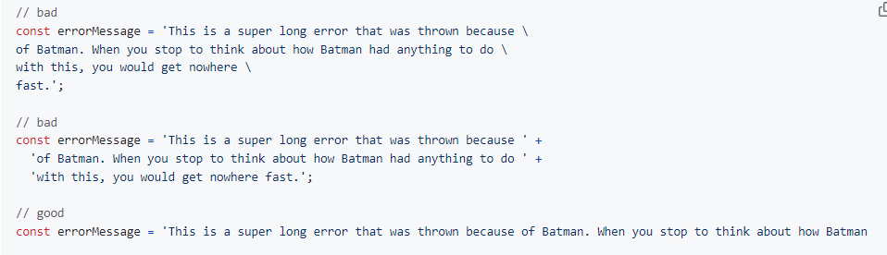
6. Strings
Strings that cause the line to go over 100 characters should not be written across multiple lines using string concatenation
broken strings are painful to work with and make code less searchable.

Slide 15
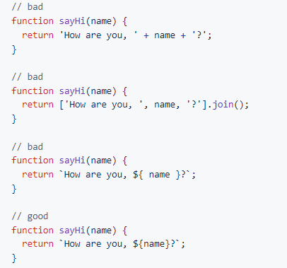
6. Strings
When programmatically building up strings, use template strings instead of concatenation

Slide 16
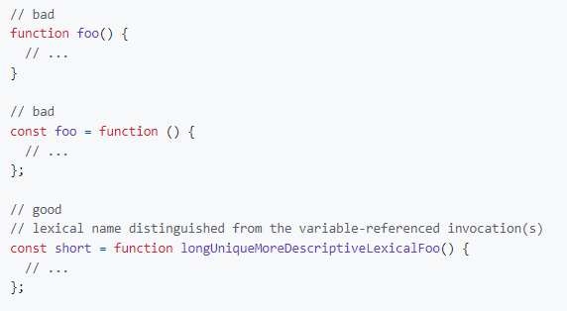
7. Functions
Use named function expressions instead of function declarations

Slide 17
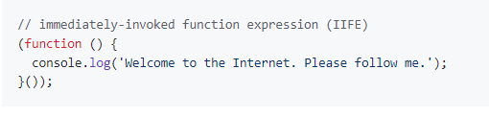
7. Functions
Wrap immediately invoked function expressions in parentheses
Never declare a function in a non-function block (if, while, etc.)
Assign the function to a variable instead
Browsers will allow you to do it, but they all interpret it differently

Slide 18
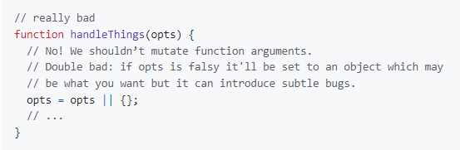
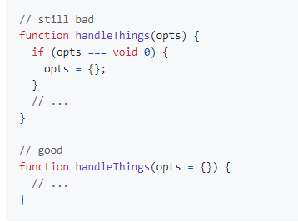
7. Functions
Never name a parameter arguments
this will take precedence over the arguments object that is given to every function scope
Use default parameter syntax rather than mutating function arguments.

Slide 19
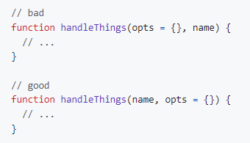
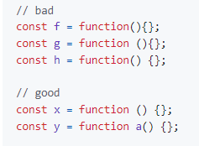
7. Functions
Always put default parameters last
Spacing in a function signature

Slide 20
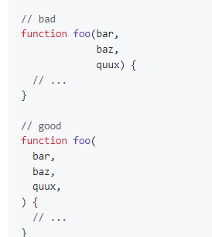
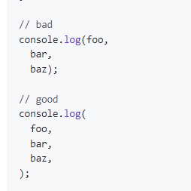
7. Functions
Functions with multiline signatures, or invocations, should be indented just like every other multiline list in this guide: with each item on a line by itself, with a trailing comma on the last item

Slide 21
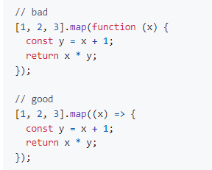
8. Arrow Functions
When you must use an anonymous function (as when passing an inline callback), use arrow function notation
It creates a version of the function that executes in the context of this
If you have a fairly complicated function, you might move that logic out into its own named function expression

Slide 22
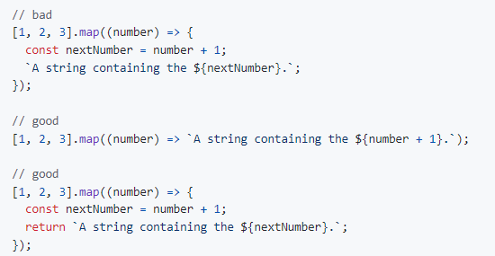
8. Arrow Functions
If the function body consists of a single statement returning an expression without side effects, omit the braces and use the implicit return

Slide 23
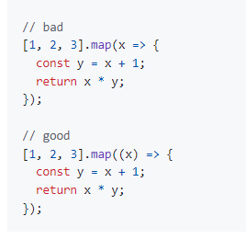
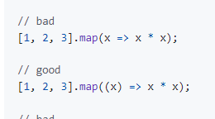
8. Arrow Functions
Always include parentheses around arguments for clarity and consistency

Slide 24
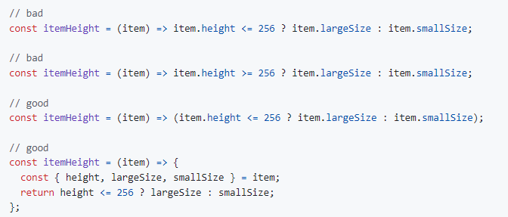
8. Arrow Functions
Avoid confusing arrow function syntax ( => ) with comparison operators
( <= , >= )

Slide 25
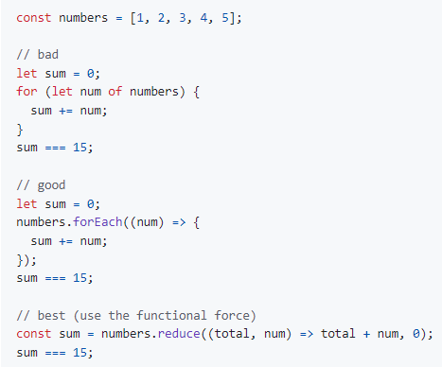
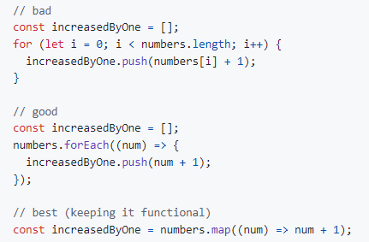
9. Iterators
Don’t use iterators. Prefer JavaScript’s higher-order functions instead of loops like for-in or for-of

Slide 26
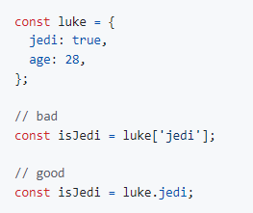
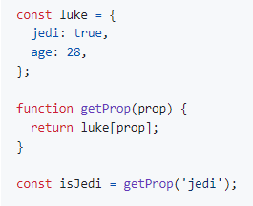
10. Properties
Use dot notation when accessing properties
Use bracket notation [ ] when accessing properties with a variable

Slide 27
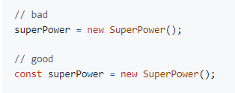
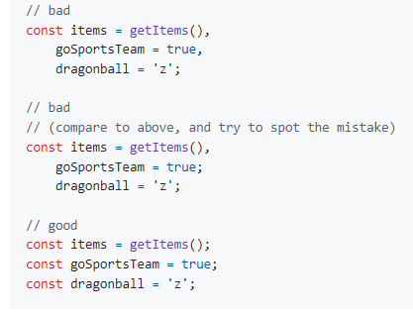
11. Variables
Always use const or let to declare variables
Not doing so will result in global variables
We want to avoid polluting the global namespace
Use one const or let declaration per variable
or assignment

Slide 28
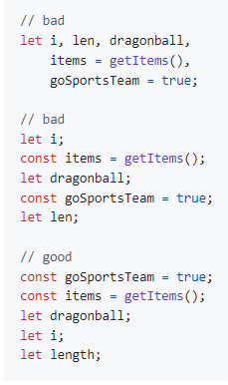
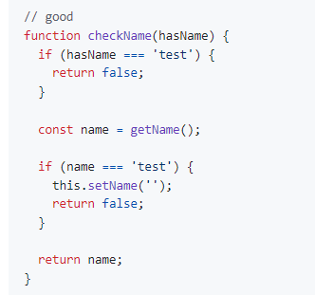
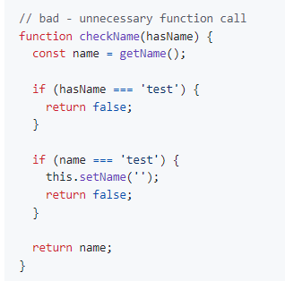
11. Variables
Group all your consts and then group all your lets
Assign variables where you need them, but place them in a reasonable place

Slide 29
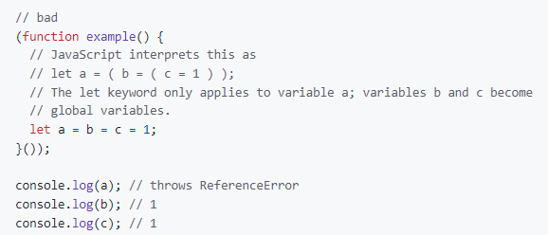
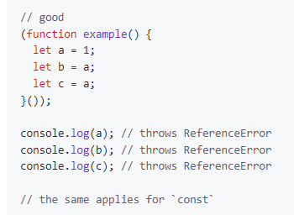
11. Variables
Don’t chain variable assignments

Slide 30
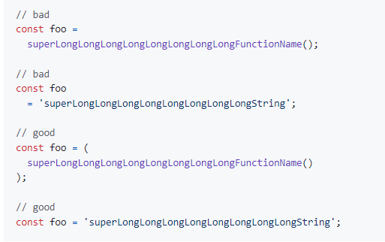
11. Variables
Avoid using unary increments and decrements ( ++ ) , ( -- )
Avoid linebreaks before or after = in an assignment
If your assignment violates max-len, surround the value in parens

Slide 31
12. Hoisting
var declarations get hoisted to the top of their closest enclosing function scope, their assignment does not
const and let declarations are blessed with a new concept called Temporal Dead Zones (TDZ)
Function declarations hoist their name and the function body.

Slide 32
13. Comparison Operators & Equality
Strings evaluate to false if an empty string '', otherwise true
Use === and !== over == and !=
Conditional statements such as the if statement evaluate their expression using coercion with the ToBoolean abstract method and always follow these simple rules:
Objects evaluate to true
Undefined evaluates to false
Null evaluates to false
Booleans evaluate to the value of the boolean
Numbers evaluate to false if +0, -0, or NaN, otherwise true
Strings evaluate to false if an empty string ‘ ‘, otherwise true

Slide 33
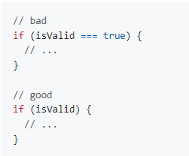
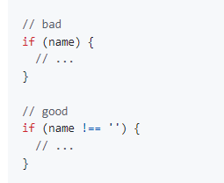
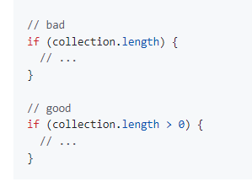
13. Comparison Operators & Equality
Use shortcuts for booleans, but explicit comparisons for strings and numbers

Slide 34

13. Comparison Operators & Equality
Ternaries should not be nested and generally be single line expressions

Slide 35

13. Comparison Operators & Equality
Avoid unneeded ternary statements
The nullish coalescing operator (??) is a logical operator
that returns its right-hand side operand when its left-hand
side operand is null or undefined

Slide 36

14. Blocks
Use braces with all multiline blocks

Slide 37

14. Blocks
If you’re using multiline blocks with if and else, put else on the same line as your if block’s closing brace.

Slide 38

15. Control Statements
In case your control statement (if ,while, etc.) gets too long or exceeds the maximum line length each (grouped) condition could be put into a new line

Slide 39

16. Comments
Use /* …. */ for mutliline comments
Use // for single line comments
Place single line comments on a newline above the subject of the comment. Put an empty line before the comment unless it’s on the first line of a block

Slide 40


16. Comments
Use // FIXME: to annotate problems
Use // TODO: to annotate solutions to problems

Slide 41
17. Whitespace
Remember to always format your files after updating them!

Slide 42


18. Commas
Don’t use leading commas
Use additional trailing commas

Slide 43

19. Type Casting & Coercion
Perform type coercion at the beginning of the statement
Strings

Slide 44


19. Type Casting & Coercion
Numbers
Use Number for type casting
Use parseInt with radix for parsing strings
Booleans

Slide 45
20. Naming Conventions
Avoid single letter names, Be descriptive with your naming
Use camelCase when naming objects, functions, and instances
Use PascalCase only when naming constructors or classes
Do not use trailing or leading underscores
Acronyms and initialisms should always be all uppercased, or all lowercased.

Slide 46

21. Accessors
Do not use JavaScript getters/setters as they cause unexpected side effects and are harder to test, maintain, and reason about
If the property/method is a Boolean, use isVal() or hasVal()

Slide 47


22. Events
When attaching data payloads to events (whether DOM events or something more proprietary like Backbone events), pass an object literal (also known as a "hash") instead of a raw value

Slide 48

23. jQuery
Prefix jQuery object variables with a $

Slide 49
24. Standard Library
Use Number.isNan instead of global isNan
The global isNan coerces non-numbers to numbers, returning true for anything that coerces to NaN
Use Number.isFinite instead of global isFinite
The global isFinite coerces non-numbers to numbers, returning true for anything that coerces to a finite number.

